Slide 1
Search Engines are BIG Business
COMP 336 Dik Lun LEE Department of Computer Science, HKUST, Slide <number>

Slide 2
Business Models (I): Licensing
Search engine licensing: sell SE software to companies to support their intranet and/or internet web search
  Ultraseek (originally developed by infoseek, then acquired by Verity [12/2002] , which was then acquired by Autonomy [2005], which was then acquired by HP [2011] )
  Altavista (acquired by Overture [4/2003] which was then acquired by Yahoo [10/2003] )
  Google Appliance (Google search software bundled on hardware)
COMP 336 Dik Lun LEE Department of Computer Science, HKUST, Slide <number>

Slide 3
Business Models (II): Service
Provide search to portals (e.g., Yahoo)
  Search submitted to Yahoo are forwarded to third-party search engines:
    Altavista [97-98], Inktomi [99-00] , Google [01-03] , Yahoo’s own [03-11], Bing [12-now]
  Third-party search engines provide hardware and software infrastructures
  Yahoo pays third-party search engines for the service
COMP 336 Dik Lun LEE Department of Computer Science, HKUST, Slide <number>

Slide 4
Business Models (III): ASP
Search engine provider acts as an ASP (Application Service Provider)
Search engine provider is responsible for the hardware and software infrastructure and keeps the index up-to-date
Client companies only need to maintain a search page to submit queries to the search engine and get back the results to display
A’s search page
A’s index
A’s web site
A’s users
Search engine
Crawler
B’s users
Search engine company
B’s search page
B’s index
B’s web site
COMP 336 Dik Lun LEE Department of Computer Science, HKUST, Slide <number>

Slide 5
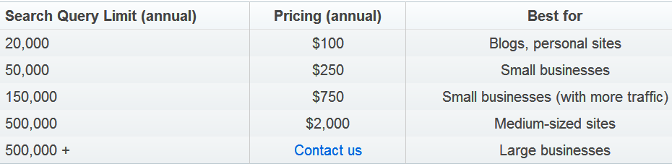
Business Models (III): ASP
Google Site Search
  If your website displays Google Ads (as in Adsense), you don’t have to pay but even receive money from Google
Atomz (www.atomz.com)
  atomz now is free and supported by text ads! Charging anything other than ads seems to be impossible on Internet!
COMP 336 Dik Lun LEE Department of Computer Science, HKUST, Slide <number>

Slide 6
Business Models (IV): Advertisement
Selling advertisements
  Traditional online ads: popup windows and banners; blindly displayed or according to URLs
  Keyword-based ads: advertisements are associated with keywords; when query contains a keyword, associated advertisement(s) will be displayed
    Google adwords (www.google.com/adwords) and Overture (www.overture.com)
query
query
Web index
Search engine
or “organic” results
query
“Algorithmic” search results
Advertisement index
Advertisements or “paid search results”
COMP 336 Dik Lun LEE Department of Computer Science, HKUST, Slide <number>

Slide 7
If Search Services are Free …
Can you charge users for their queries? Consider:
    Information returned by search engines are public and free
    All search engines are more or less the same
    Search engines provide added values via high-quality and speedy search results
Experience tells us that internet services can rarely charge a fee because as long as there are competing free search engines somewhere, users will leave you if you charge them, unless …
  The search engine has unique and valuable information (e.g., economic and business data, high quality news such as Financial Times)
If search is free, what does a search company make money?
  Get traffic and turn monetize the traffic: Google Adwords and Adsense
  More important: know what users are looking for (DVD? Vacation info?)
    Create high-quality targeted advertisements and charge the advertisers
COMP 336 Dik Lun LEE Department of Computer Science, HKUST, Slide <number>

Slide 8
Adwords = Ads + Search Engine + Portals
queries
queries
Users search through portals or directly on search sites
portals
portals
portals
queries
queries
Search engine pulls up ads with users’ keywords and return them with the regular search results
Search engine
Query keywords
Advertising network
Advertisers submit ads and buy keywords to associate to the ads
COMP 336 Dik Lun LEE Department of Computer Science, HKUST, Slide <number>

Slide 9
Adsense = Adwords without Search Engine
clicks
clicks
clicks
Users navigate web pages
website
website
website
URLs
URLs
URLs
Adsense analyzes web page contents and extract keywords
Adsense
Page keywords
Advertising network
Advertisers submit ads and buy keywords to associate to the ads
COMP 336 Dik Lun LEE Department of Computer Science, HKUST, Slide <number>

Slide 10
Relationship between Search Engines and Portals
Is a search engine a portal? Or is a portal a search engine?
  When search engines were still niche web applications, they needed major portals as outlets for displaying advertisements signed up by the search engines
  As Google becomes more and more popular, it is itself a popular portal, but it still needs more channels (e.g., AOL) to display its ads
    Add Gmail, Google Map, etc., to create wider outlets for its ads
    Create Adsense as a massive and distributed ad distribution network
    Google has become a portal itself through its popular web search and other services (thus making itself a competitor of Yahoo!, etc.)
COMP 336 Dik Lun LEE Department of Computer Science, HKUST, Slide <number>

Slide 11
Pure Ad Serving Engines
  Overture (overture.com) is an advertisement network without a “traditional” search engine
    It creates a search engine purely on advertisements
    Advertisements are ranked by the money paid by the advertisers
  Overture was: Too unpopular to attract clicks to its advertisements directly
    Has to rely on Yahoo and other portals to carry advertisements; vulnerable to losing outlets
      Yahoo! finally acquired Overture
    E.g., in Fall 2003, Looksmart (www.looksmart.com), another ad serving engine, lost partnership with MSN, which accounts for 2/3 of its business, leading to its stock price to fall 60% on the same day and the subsequent closing of its UK office
COMP 336 Dik Lun LEE Department of Computer Science, HKUST, Slide <number>

Slide 12
Getting the Traffic is More and More Important
Traditionally, portals pay search engine companies (SECs) for their search services
With advertisement, SECs pay portals to increase search traffic
Search engines often pay 50% to 70% of the ad income to their ad channel partners
COMP 336 Dik Lun LEE Department of Computer Science, HKUST, Slide <number>

Slide 13
Look at Google as an Example [Q4/2004]
Google-Sites Revenues
  Google-owned sites generated $530 million or 51% of total revenues. This represents an increase of 118% over the fourth quarter of 2003
The Google Network
  Revenues generated on Google's partner sites, through AdSense programs, contributed $490 million, or 48% of total revenues, a 92% increase over the Network revenues generated in the same quarter last year.
TAC - Traffic Acquisition Costs
  The portion of revenues shared with Google's partners, increased to $378 million or 77% of Google Network revenues. This compares to total payments to partners of $216 million in the fourth quarter of 2003, or 85% of Google Network revenues
Details: http://home.businesswire.com/portal/site/google/index.jsp?ndmViewId=news_view&newsId=20050201006016&newsLang=en
COMP 336 Dik Lun LEE Department of Computer Science, HKUST, Slide <number>

Slide 14
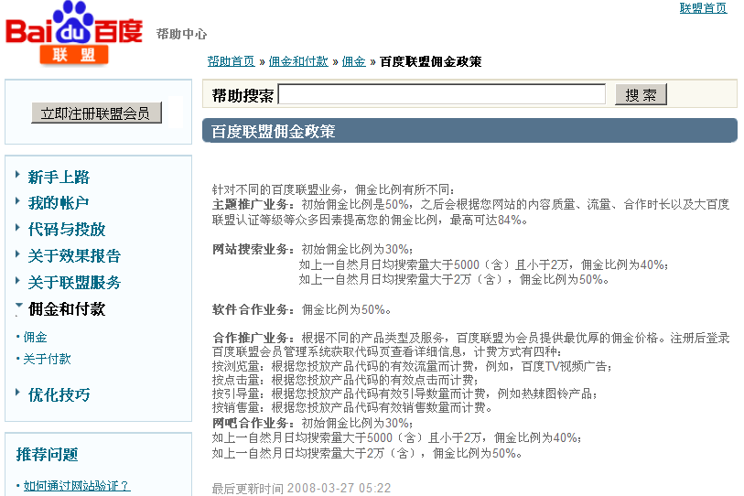
Baidu Example
Original page
English translation
COMP 336 Dik Lun LEE Department of Computer Science, HKUST, Slide <number>

Slide 15
Search Engine Marketing/Placement/Optimization (SEM/SEP/SEP)
How to promote your web site?
  Bid for a keyword and pay for each click referred to you from the search engine
  Try to make your web pages ranked high in the algorithmic part of the search engine (i.e., free-of-charge)
A search engine marketing (SEM) company helps clients how to promote their web sites on search engines
  To have your web site included in many search engines
  Identify important keywords in your business
  Make your pages rank high in search engines for those important keywords
COMP 336 Dik Lun LEE Department of Computer Science, HKUST, Slide <number>

Slide 16
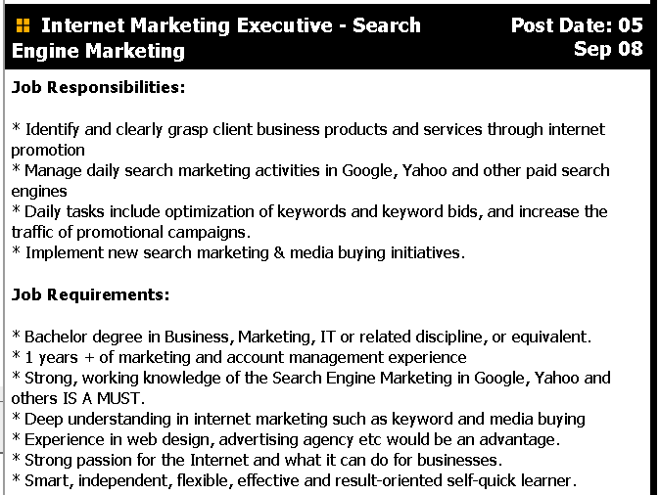
A Job Ad for SEM
COMP 336 Dik Lun LEE Department of Computer Science, HKUST, Slide <number>

Slide 17
Pay-for-Placement (PFP)
Search engines that rank results purely based on how much the sites pay for the query keywords
  Usually sites can bid for keywords in real time
  Usually sites pay based on the number of impressions displayed
Paid-search revenue grew 40% in 2002 to US$ 1.4b
  Up to 23% of the US$ 6b online advertising market, which shank 17% in 2002
  2003: will grow by 43% to US$ 2b – US Bancorp forecast
In order to generate traffic, paid-search engines have to collaborate with portals such as Yahoo!
  Cost per click averages to 35 cents, cheaper than $1-per-lead average of Yellow Pages advertisements
  Overture pays 21 cents to Yahoo!, keeping only 14 cents to itself
  Charge becomes deeper and deeper: 51% in 2001 to 63% in 2003
COMP 336 Dik Lun LEE Department of Computer Science, HKUST, Slide <number>

Slide 18
Pay-by-Impression (CPM – Cost Per Mille)
Successful display of an advertisement (typically image/flash)
Like traditional media, does not care if the user is interested in the ad or has actually seen the ad
CPM (Cost Per Mille): The cost for displaying the ad 1000 times
COMP 336 Dik Lun LEE Department of Computer Science, HKUST, Slide <number>

Slide 19
Pay-per-Click (PPC)
Advertiser pays the search engine for each click
Performance-based marketing
Simply displaying an ad does not cost any money
Advertiser pays only when someone clicks on the advertisement
COMP 336 Dik Lun LEE Department of Computer Science, HKUST, Slide <number>

Slide 20
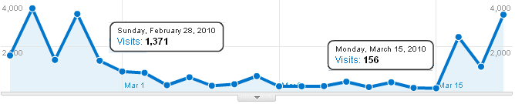
Impact of Dropping off from Google
An example: A website (that I am familiar with) was dropped from Google’s index in a certain period of time
COMP 336 Dik Lun LEE Department of Computer Science, HKUST, Slide <number>

Slide 21
What do “We” as software professionals gain from it?
"High quality, talented search engineers are in very short supply these days. Regardless of how good your planning process is, at the end of the day it comes down to people and chemistry.” Jeff Weiner, Yahoo's senior vice president of search and marketplace commenting on Yahoo’s replacement of Google with Yahoo’s own search engine [Feb 2004]
“We think the sun has not set on even the first day of the search opportunity… We certainly envision a world where we can answer persons' questions much, much better. I think the dream case is that we can actually answer the question directly: How many cups in a gallon? How far is it to the moon? What time does the ferry leave? What are the top 10 stocks?” Yusuf Mehdi, MSN Chief, Microsoft
COMP 336 Dik Lun LEE Department of Computer Science, HKUST, Slide <number>

Slide 22
Brief History of Search Engines
1994 | Yahoo! | directory service and search engine
 | Infoseek | Acquired by Disney in 1998 and merged into Disney’s go.com, dumped by go.com in 2001
1995 | Inktomi | Acquired by Yahoo! In 2003
 | Altavista | Acquired by Overture in 2003
1996 | Ask Jeeves | www.ask.com, acquired by IAC/InterActiveCorp in 2005
1997 | Overture | Pay-per-clcik search engine, acquired by Yahoo! in 2003
1998 | Google | IPO in 2004
1999 | Alltheweb | Acquired by Overture in 2003
2003 |  | Yahoo! Acquired Overture -> Alltheweb -> Altavista
2004 | Google | IPO
2009 | Bing | MSN search back in 2006
COMP 336 Dik Lun LEE Department of Computer Science, HKUST, Slide <number>

Slide 23
Brief History of Search Engines
1994
1995
1996
1997
1998
1999
2000
2001
2002
2003
2004
2005
2006
Yahoo!
Infoseek
Altavista
Inktomi
Ask Jeeves
Ask.com
Overture
Google
Disney
Go.com
Abandoned
IPO
msn.com
2009 Bing
2008 powered by Google
COMP 336 Dik Lun LEE Department of Computer Science, HKUST, Slide <number>

Slide 24

Pre-consolidation (Everybody is a Friend)
MSN
Portals
Yahoo!
Google
Search Engines
Inktomi
Ad networks
Overture
Overture: companies pay to have their pages shown at the top; pioneered (and patented) pay-for-rank; no search engine for itself
Inktomi: pure search engine; no portal and advertisement business; served Yahoo! before expelled by Google (dash line)
Advertisers
COMP 336 Dik Lun LEE Department of Computer Science, HKUST, Slide <number>

Slide 25
Google becoming a Portal (and a Threat)
MSN
Portals
Yahoo!
Google
Search Engines
Inktomi
Adwords
Ad networks
Overture
Alta Vista
Advertisers
Advertisers
COMP 336 Dik Lun LEE Department of Computer Science, HKUST, Slide <number>

Slide 26
Consolidation
Suddenly, Microsoft is left without any search engine and ad network! Wouldn’t Microsoft use services from its competitor?
MSN
Yahoo!
Google
Inktomi
Adwords
Ad networks
Overture
Alta Vista
Advertisers
Advertisers
COMP 336 Dik Lun LEE Department of Computer Science, HKUST, Slide <number>

Slide 27
The Big Three
MSN Live
Adcenter
MSN
Yahoo!
Google
Search
Adwords
Overture
Advertisers
Advertisers
COMP 336 Dik Lun LEE Department of Computer Science, HKUST, Slide <number>

Slide 28
The Big Two
Bing Adcenter
Bing
Yahoo!
Advertisers
Google
Adwords
Advertisers
COMP 336 Dik Lun LEE Department of Computer Science, HKUST, Slide <number>

Slide 29
Legal Problems of Selling Trademarked Keywords
Research shows that many inquiries at search engines are for brand names, or trademarked terms. Within the finance category, for example, >50% of total searches are for branded keywords, such as Wells Fargo. 25%-30% of those people searching for a brand name will then search for a competitive brand, such as Bank of America [ComScore Networks]
Shopping sites like NexTag and Shopping.com allow merchants to bid on trademarked terms to turn up in search results. Claria and WhenU.com allow marketers to buy and deliver pop-up ads when consumers visit their rivals' Web sites. Claria faces numerous lawsuits related to its trademark policies.
COMP 336 Dik Lun LEE Department of Computer Science, HKUST, Slide <number>

Slide 30
[2/2005] Louis Vuitton sued Google and its French subsidiary for similar alleged trademark infringement. A French court ordered Google to cease the practice and pay a fine.
  [6/2006] The Paris Court of Appeals Confirms Sanctions against Google for Trademark Counterfeiting, Unfair Competition and Misleading Advertising, Louis Vuitton Press Release http://biz.yahoo.com/bw/060628/20060628005804.html
  [6/2006] Vuitton tops Google in Paris court, International Herald Tribune http://www.iht.com/articles/2006/06/28/business/lvmh.php
COMP 336 Dik Lun LEE Department of Computer Science, HKUST, Slide <number>

Slide 31
[1/2004] After 5 years of dispute, Court ruled that Playboy could pursue charges that Excite and Netscape violated its trademark by selling banner ads on terms "playboy" and "playmate” causing consumer confusion and brand dilution related to Playboy's trademarks. America Online settled the case with Playboy for an unspecified amount.
[9/2004] Judge Brinkema denied Google and Overture's motion to dismiss six charges brought by Geico, which alleged that the search companies' use of its name to trigger search-related advertisements was trademark infringement, unfair competition and dilution of its marks under the Lanham Act.
  Update: [12/2004] U.S. District Judge rejected the claim from Geico
COMP 336 Dik Lun LEE Department of Computer Science, HKUST, Slide <number>

Slide 32
Trademarked versus non-trademarked search terms:
  Trademarked search terms can divert customers from trademark owner’s business?
  It is difficult to establish web users' intent when they type in a search term. For example, typing in "Apple" could signal a web surfer's interest in the fruit just as well as the trademark name of Apple Computer.
Ref:
“Google plans trademark gambit” CNET News.com, Apr 13, 2004
“Geico gets green light to sue Google, Overture” CNET News.com, Sept 2004
COMP 336 Dik Lun LEE Department of Computer Science, HKUST, Slide <number>

Slide 33
Supplementary Slides
(Look at them only if you are interested in history)
COMP 336 Dik Lun LEE Department of Computer Science, HKUST, Slide <number>

Slide 34
The Business Value of Search Engine
Users looking for products would type the product name into a search engine (28 percent), browse shopping 'channels' (5 percent) or click on ads (4 percent). -- Jupiter Media Metrix & NPD (March 2001)
  35% of searches are for products and services
“You’re finding a customer who’s looking for Las Vegas hotels. You can’t find a more qualified buyers,” Jason Pruismann, promotions director at Travelocity.com
Nine out of 10 users visit a search engine, portal or community site each month, and revisit them nearly five times per month.
  Nielsen//NetRatings (May 2001)
COMP 336 Dik Lun LEE Department of Computer Science, HKUST, Slide <number>

Slide 35
Does Search Engine Advertising Really Work?
From The New York Times, Apr 13, 2003:
“Ms. Ge’Lena Vavra, a suit importer in Las Vegas, was selling about 10 suits a month over eBay. Then she bought 50 Google keyword ads, varying from 21 cents to $1.5 per keyword such as Armani or Hugo Boss.
The next morning, she said, sales took off. She now sells almost 120 suits a month. She expects to spend US$60,000 this year on Google search ads”
“Our business exploded from Google, and Google alone.” said Ge’Lena Vavra
Google has about 100,000 advertisers
COMP 336 Dik Lun LEE Department of Computer Science, HKUST, Slide <number>

Slide 36
Growth of the Search Market
Search is the third-largest Internet market after e-commerce and advertising
Expected to be a $7 billion industry internationally by 2007 - a compounded annual growth rate of more than 30%
Will outstrip growth in e-commerce by end of 2004
Growth in Yahoo! US$140m (02) → 65m 3Q/03 → 124m 3Q/04
Google: US$294m (02) → 512m (4Q/03) → $1b (4Q/04)
→ $3b (4Q/06) market value US$ 55b more than Ford and GM combined!
MSN.com: US$138m (02)
Why? search is the most efficient way to find products and information and the best way for advertisers to acquire customers
These numbers had not been updated since Google became a public company
http://www.internetretailer.com/dailyNews.asp?id=9104 quoting report from equity research firm US Bancorp Piper Jaffray Research
COMP 336 Dik Lun LEE Department of Computer Science, HKUST, Slide <number>

Slide 37
Google’s Business Profile
Investment
  8/1998: US$ 1m from founders (Brin and Page), and families and friends
  2/1999: US$ 25m from Kleiner Perkins and Sequoia Capital
  2000: US$ 10m from Yahoo!
Revenue:
  2001: US$ 70m (estimated)
  Income from providing search to Yahoo! US$ 7m/year
  2003: lined up for IPO, reporting US$300m revenue and US$100m profit; expecting US$750m in 2003
People:
  2001: 250
  2002: 400 (15% with Ph.D. degrees)
  2003: 800
  12/2004: 3021 FT employees
These numbers had not been updated since Google became a public company
COMP 336 Dik Lun LEE Department of Computer Science, HKUST, Slide <number>

Slide 38
Google’s Business Profile
Hardware infrastructure:
  15,000 servers in 5 data centers (8/2002)
  54,000 servers, containing 100,000 CPUs and 261,000 disks, in 8 data centers (Apr 2003, NYT news article)
  400,000 servers 2006
Number of hits per days = 50 million (2002)
Number of pages = 2.1 billion (2002) 8.2 billion (2005)
Income:
  Advertisement: Cost-per-Click Adword program (after experiencing with impression-based scheme for a few months)
  Provides search service to over 130 companies and government agencies (2002)
  Sells Google Appliance: Google-in-a-Box for intranet applications
  2002: estimated to make US$350m-400m revenue
  2004: IPO at Nasdaq with market value US 11b (2/2005)
These numbers are not updated since Google became a public company
COMP 336 Dik Lun LEE Department of Computer Science, HKUST, Slide <number>

Slide 39
References
Google Inks Ad Deal With U.K. Insurance Co. http://siliconvalley.internet.com/news/article.php/1437921
Worst and Best Picks (on Google going IPO) http://www.forbes.com/forbes/2003/0106/037_print.html
COMP 336 Dik Lun LEE Department of Computer Science, HKUST, Slide <number>

